Slide 1
A talk on a difficult topic

Slide 2
Abortion: What is my opinion?

Slide 3
Facts - the rough figures (annual without unreported cases)
Switzerland 11.000 abortions
Germany 100.000 abortions
Austria 45.000 abortions
France 207.000 abortions
Italy 170.000 abortions
UK/Wales 215.000 abortions
Australia 93.000 abortions
USA 900.000 abortions
TOTAL 1’741.000 abortions (excluding India, Asia, Eastern Countries)

Slide 4
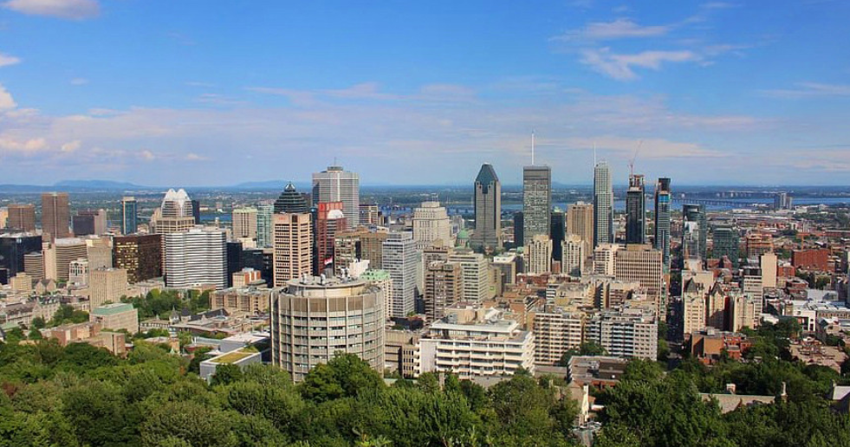
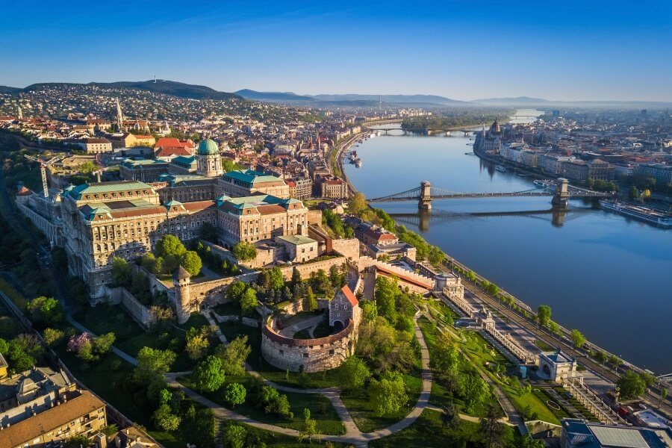
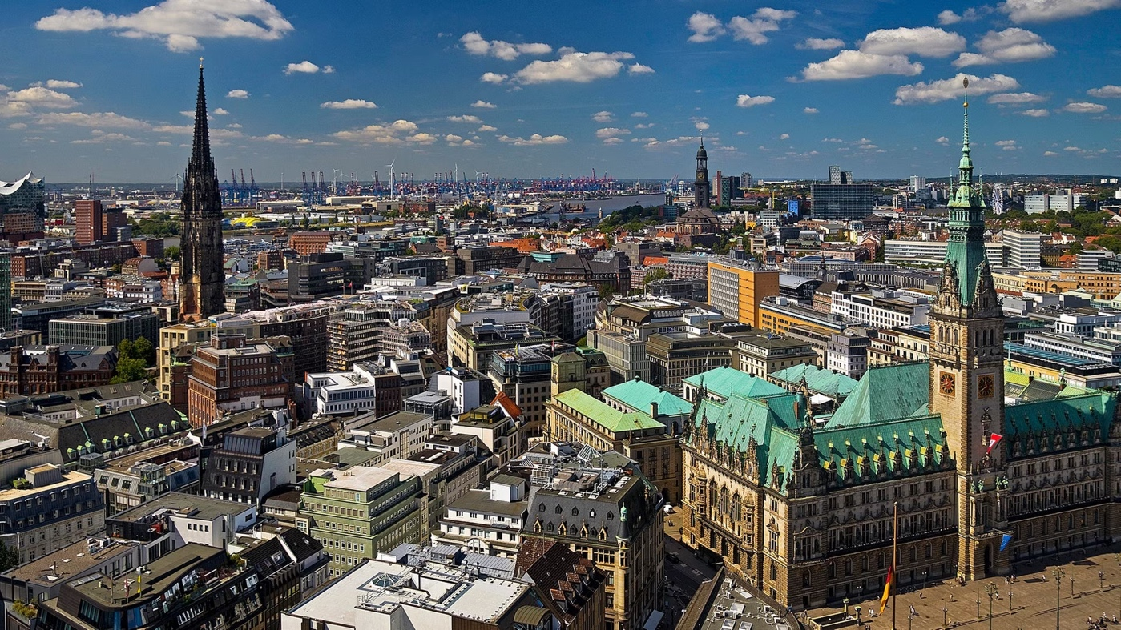
Facts - the rough figures (annual without unreported cases)
Montreal
Budapest
Hamburg

Slide 5
Why do people have abortions?

Slide 6
Facts - the four most important reasons for abortions (in descending order)
biographical reasons or timing of the pregnancy
2. partnership problems and relationship status
3. overstrain
4. medical reasons

Slide 7
The least frequently cited reason for abortion is for medical reasons. What does that implicate?

Slide 8
https://youtu.be/AQOWblkSTAU

Slide 9
What is it about? Who could the 6 women be? Who are their children? What haven't I understood?

Slide 10
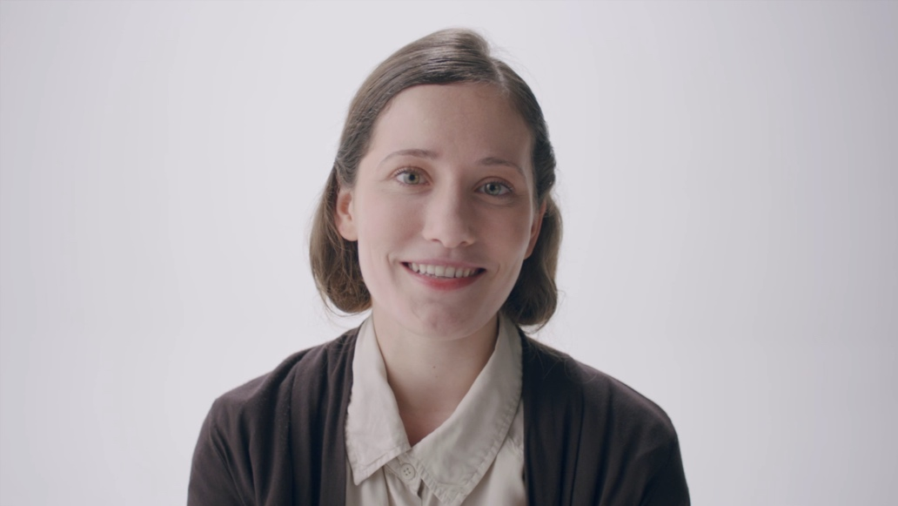
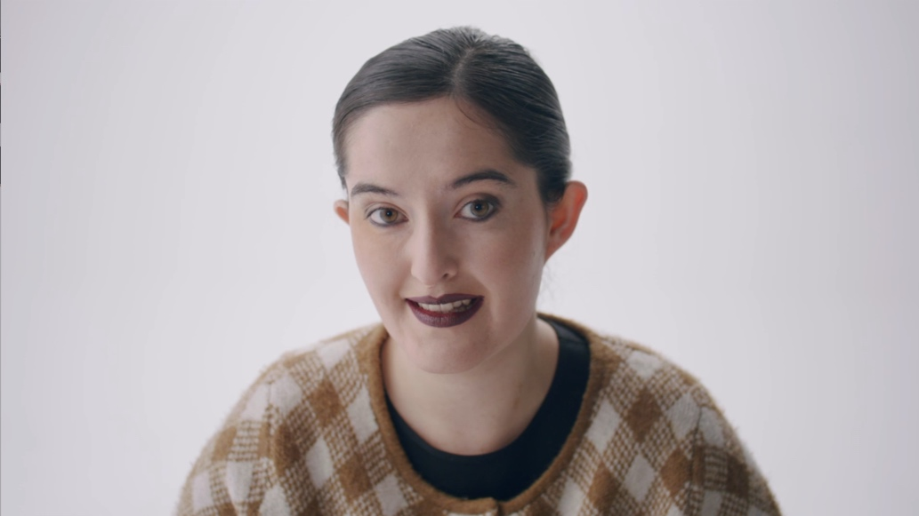
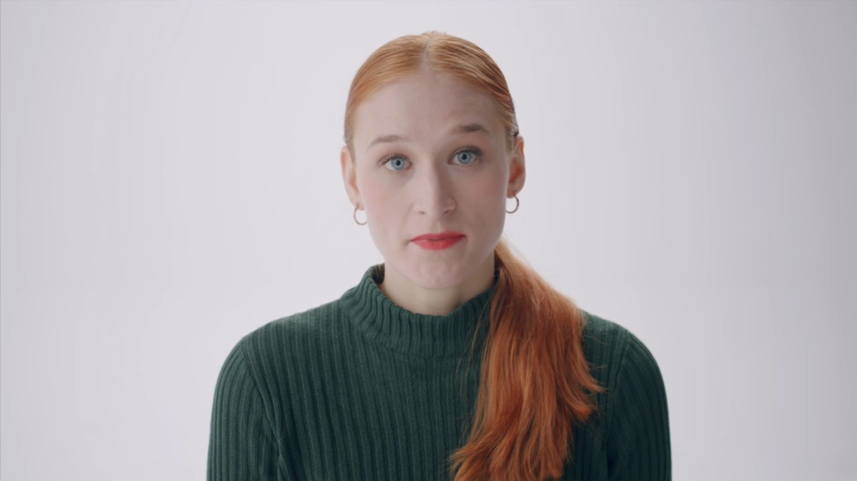
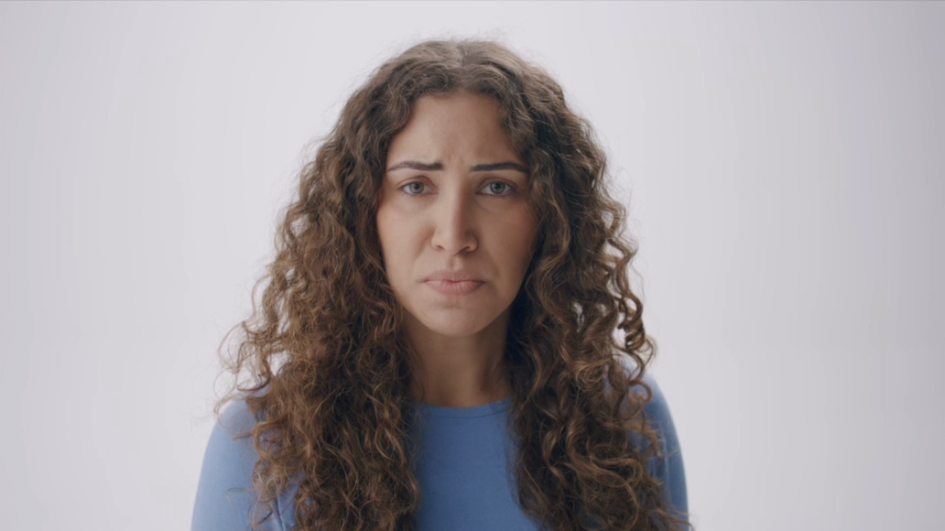
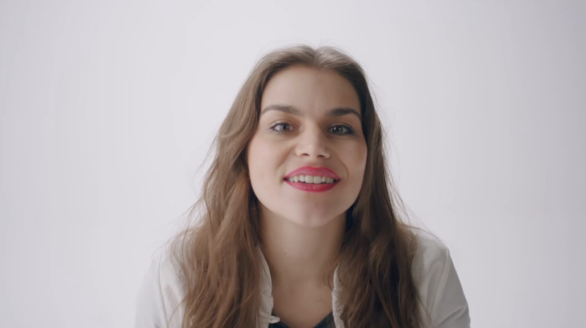
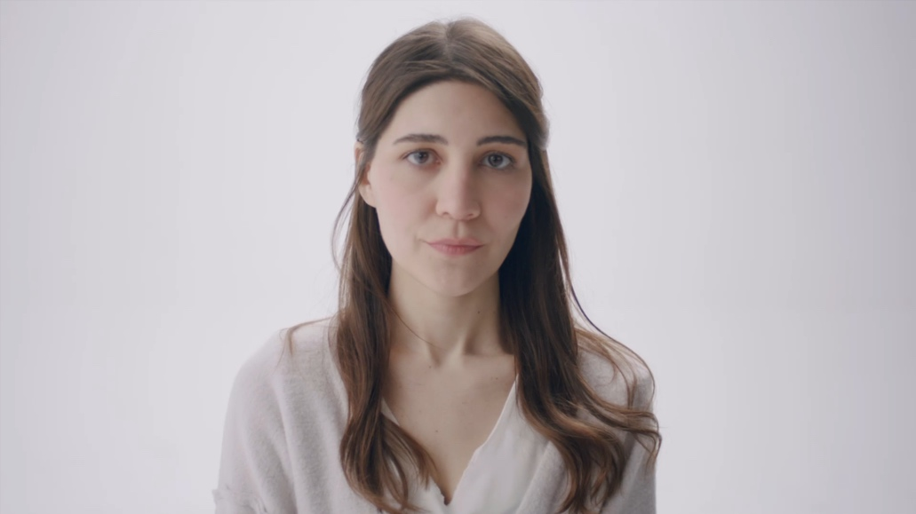
6 Frauen – 6 Schicksale
6 women – 6 destinies
Hannah Chaplin
gespielt von Eva Regan
Isobel Hawking
gespielt von Isabel M. Patterson
Hannah Chaplin
portrayed by Eva Regan
Joanne Carole Schieble Simpson
gespielt von Afra Kosa
Isobel Hawking
portrayed by Isabel M. Pattersonn
Joanne Carole Schieble Simpson
portrayed by Afra Kosa
Gladys Pearl Baker
portrayed by Malin Frank
Mary Bat Joachim
portrayed by Feride Morcay
Caterina die Meo Lippi
gespielt von Yasmine Alice
Gladys Pearl Baker
gespielt von Malin Frank
Maria Bat Joachim
gespielt von Feride Morcay
Caterina die Meo Lippi
portrayed by Yasmine Alice

Slide 11
Work in groups.
work in groups

Slide 12
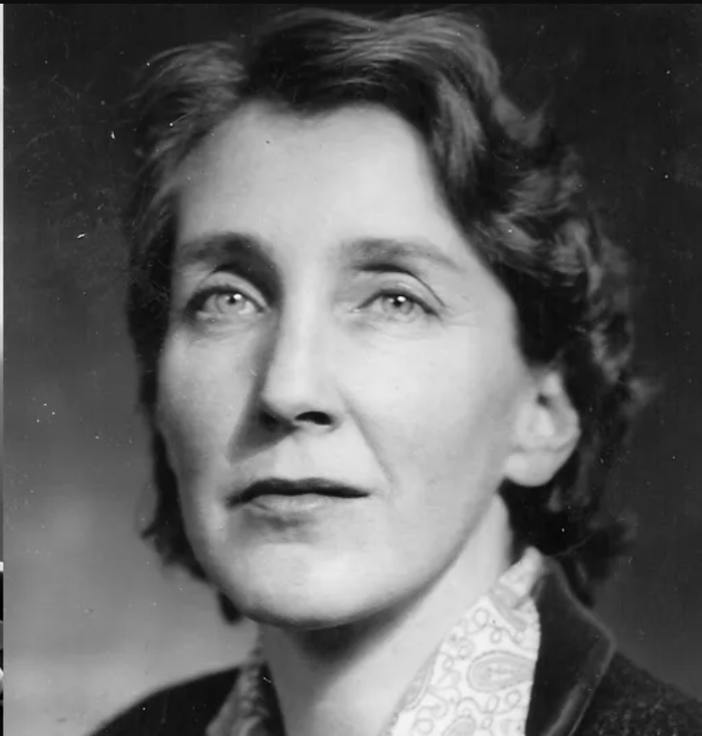
Isobel Hawking

Slide 13
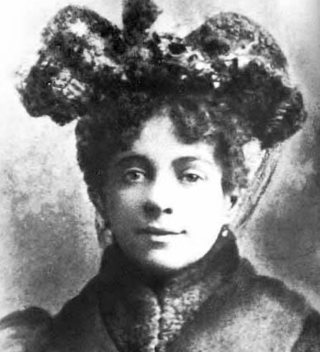
Hannah Chaplin

Slide 14
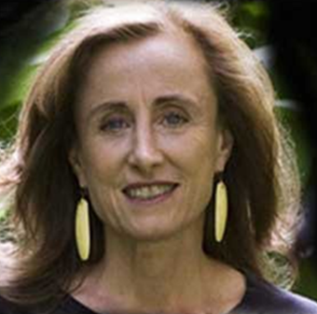
Joanne-Carol Schieble

Slide 15
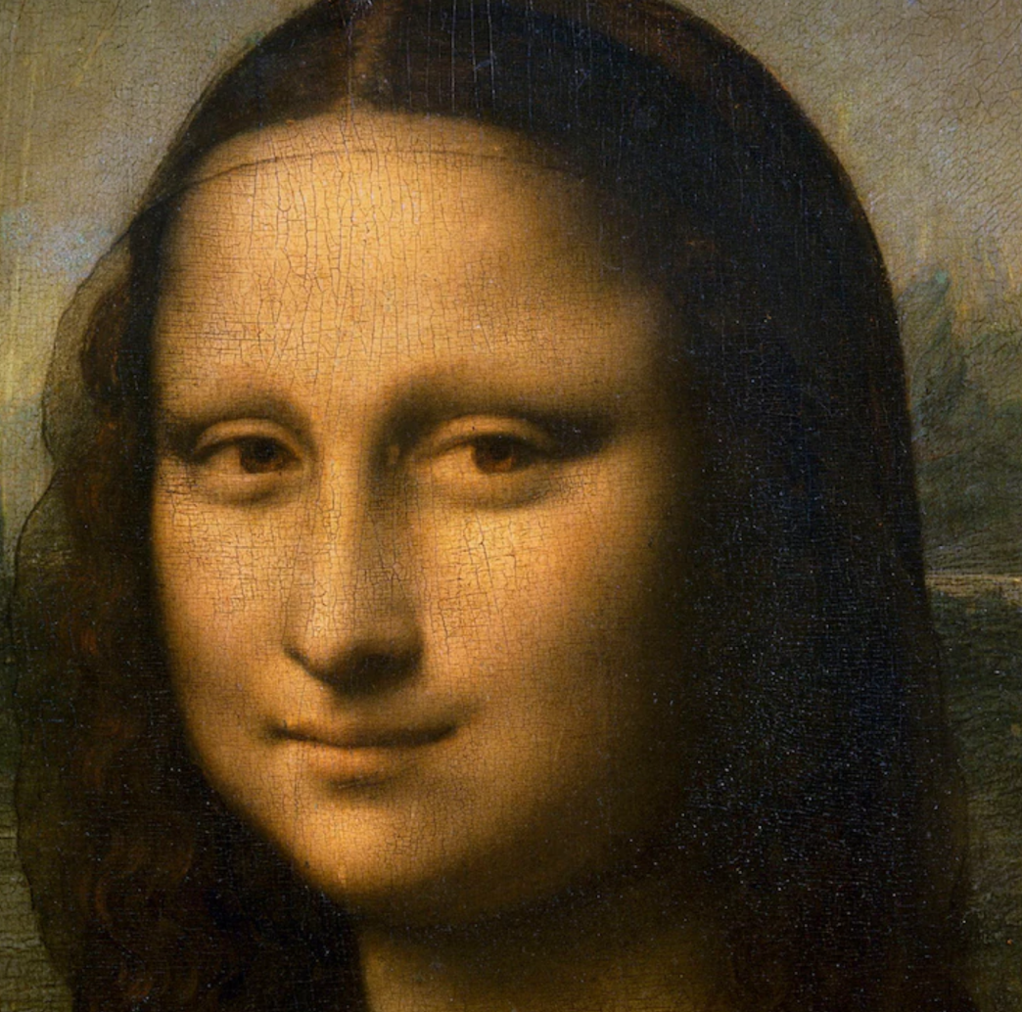
Caterina di Meo Lippi

Slide 16
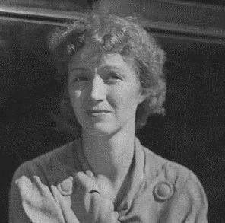
Gladys Pearl Baker

Slide 17
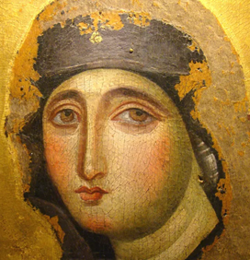
Maria Bat Joachim

Slide 18
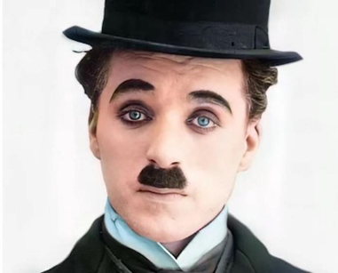
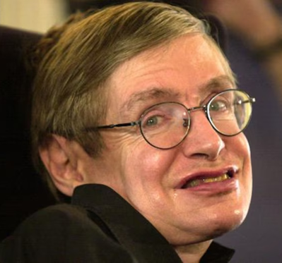
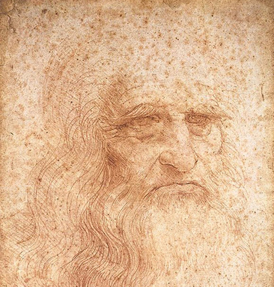
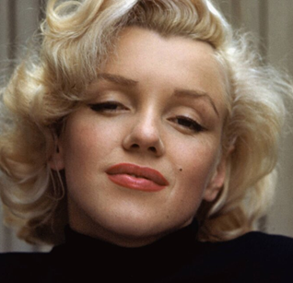
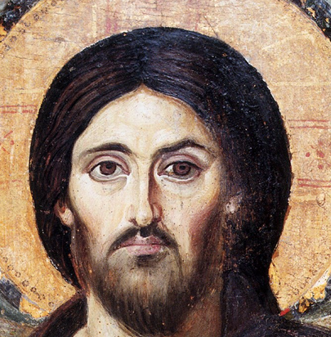
Would they be born today?
?
?
?
?
?
?
90 percent of all people diagnosed with Down syndrome are prenatally aborted.

Slide 19
How things could be changed
biographical reasons or timing of the pregnancy
2. partnership problems and relationship status
3. overstrain
4. medical reasons

Slide 20
Work in groups.

Slide 21
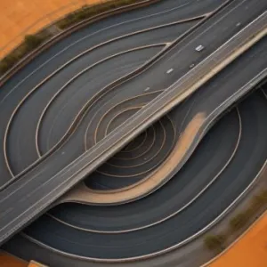
5 moral questions
1) Do we really know? 4) A disabled child?
2) Change of plans? 5) A personal word from the producer
3) Alternatives?

Slide 22
5 moral questions
1) Do we really know?

Slide 23
5 moral questions
2) Change of plans?

Slide 24
5 moral questions
3) Alternatives?

Slide 25
5 moral questions
4) A disabled child?

Slide 26
5 moral questions
5) A personal word from the producer (Bruno Waldvogel-Frei)
Fabrice

Slide 27
https://youtu.be/AQOWblkSTAU

Slide 28
What could women help who are affected by this issue?
What can we do to raise awareness of the issue in our society?
© Regula Lehmann & Bruno Waldvogel-Frei

Slide 29
Image sources
https://de.wikipedia.org/wiki/Hannah_Chaplin#/media/Datei:Hannah_Chaplin.jpg
https://www.pinterest.at/pin/57069120270426707/visual-search/?x=16&y=16&w=532&h=532
https://i2-prod.dailyrecord.co.uk/incoming/article12184627.ece/ALTERNATES/s615b/JS146311157.jpg
https://i0.wp.com/iluminasi.com/img/upload/joanne-carole-schieble-ibu-kandung-steve-jobs.jpg?w=800&quality=100
https://upload.wikimedia.org/wikipedia/commons/thumb/a/a9/Mona_Lisa_detail_face.jpg/330px-Mona_Lisa_detail_face.jpg
https://de.catholicnewsagency.com/index.php/image/advocata-nostra-sul-monte-mario-a-roma_1612778054.JPG?w=900
https://p6.focus.de/img/fotos/id_3195325/wissen-hawking.jpg?im=Resize%3D%28800%2C524%29&impolicy=perceptual&quality=mediumHigh&hash=1bf704bbeb9b0d6ee39dbd03063689f678062f1e561ae7e930206b966ad0c35d
https://64.media.tumblr.com/6dbb0211550ce0fbdc040dc504539370/4ddbfee3a6689d44-31/s1280x1920/c367f6985c0fa7ea020d13e3b8bcd10f81e3c789.jpg
https://upload.wikimedia.org/wikipedia/commons/thumb/f/f5/Steve_Jobs_Headshot_2010-CROP2.jpg/1280px-Steve_Jobs_Headshot_2010-CROP2.jpg
https://upload.wikimedia.org/wikipedia/commons/thumb/3/38/Leonardo_da_Vinci_-_presumed_self-portrait_-_WGA12798.jpg/1280px-Leonardo_da_Vinci_-_presumed_self-portrait_-_WGA12798.jpg
https://www.myself.de/Undefined/4798/image-thumb__4798__gallery-horizontal/marilyn-monroe-1@2x.webp
https://upload.wikimedia.org/wikipedia/commons/thumb/4/4a/Spas_vsederzhitel_sinay.jpg/1024px-Spas_vsederzhitel_sinay.jpg

